Slide 1













IoT-Based Weather Monitoring Device with Predictive Weather Analysis
S.Muthamil
y

Slide 2
table of
CONTENTS
1. INTRODUCTION
2. TASK 1
3. TASK 2
4. TASK 3
5. TASK 4
6. TASK 5
7. CONCLUSION

Slide 3


Introdunction
In recent years, the integration of Internet of Things (IoT) technology with weather monitoring systems has revolutionized the way we collect and analyze weather data. This presentation introduces an innovative IoT-based weather monitoring device equipped with predictive weather analysis capabilities.

Slide 4







About
TASK 1

Slide 5
Selected sensors
Temperature and humidity Sensor (DHT22): Its is a popular sensor for measuring temperature and humidity in various applications.
Rain sensor : Its also known as a rain gauge , is a device used to measure the amount of precipitation that falls over a specific period of time
Atmospheric Pressure Sensor (BMP180 ): The BMP180 sensor is a barometric pressure sensor developed by Bosch Sensortec.
The NodeMCU board: Its is an open-source IoT platform based on the ESP8266 Wi-Fi module.

Slide 6
About
TASK 2

Slide 7


Components an Communication
Protocol
COMPONENTS:
Local Network: Infrastructure for internal communication.
Centralized Server: Receives and stores data for analysis.
COMMUNICATION PROTOCOL:
HTTP (Hypertext Transfer Protocol):
web-based communication within the local network. Facilitates real-time data transfer between sensors and server.
WebSocket:
Enables full-duplex communication channels over a single TCP connection.
Ideal for real-time data transmission, ensuring low latency.
MQTT (Message Queuing Telemetry Transport):
Lightweight protocol for IoT devices, minimizing bandwidth usage.
Supports publish-subscribe messaging, enhancing scalability.

Slide 8
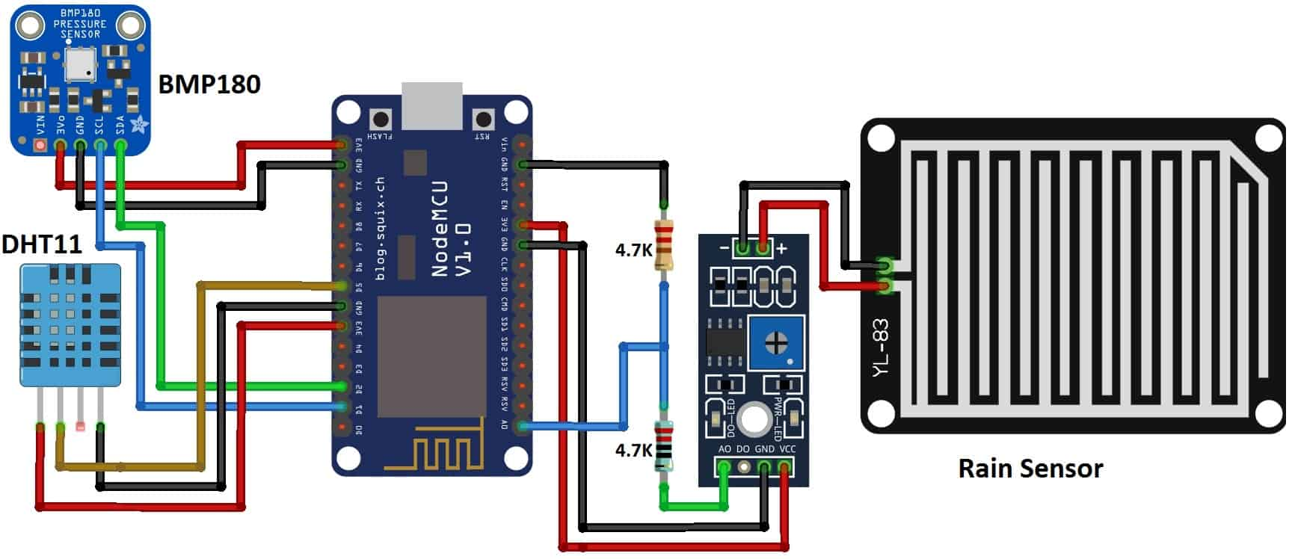
Circuit diagram

Slide 9
about
TASK 3

Slide 10
Overview
Data Collection Module:
Responsible for gathering real-time weather data from various sources such as IoT sensors, weather stations, satellites, and online APIs.
Utilizes HTTP requests to fetch data from external sources.
Data Preprocessing and Cleaning:
Filters out noisy or irrelevant data to enhance the quality of the dataset.
Handles missing values and outliers
Historical Data Storage:
Stores historical weather data in a data warehouse. efficient retrieval and analysis of past weather patterns.
.

Slide 11

Overview
Predictive Modelling and Forecasting:
Incorporates features such as temperature, humidity, wind speed, precipitation, and atmospheric pressure as predictors.
Real-time Analysis and Visualization:
Performs real-time analysis of incoming weather data streams.
Generates visualizations such as charts, graphs, and maps to represent weather patterns and trends.

Slide 12
about
TASK 4

Slide 13
Enchanced prediction Weather analysis
Weather Monitoring System: Collects real-time weather data.
External Data Source:
Satellite Imagery: Provides visual insights into weather patterns.
Meteorological Databases: Stores historical and forecast data for analysis.
Local Network: Infrastructure for internal communication.
App/Web Interface: Provides access to weather information for users.
Data Retrieval: Fetch satellite imagery and meteorological data using HTTP requests.
Data Fusion: Combine external data with real-time sensor data for comprehensive analysis.

Slide 14
about
TASK 5

Slide 15

User friendly Weather Visualization Interface
Interactive Maps: Allows users to visualize weather patterns with zoom and pan functionality.
Dynamic Charts: Presents real-time and forecasted weather data in visually engaging graphs.
Customizable Notifications: Enables users to receive alerts for specific weather conditions or events.
User Preferences: Personalization options for preferred units, locations, and display settings.

Slide 16

User friendly Weather Visualization Interface
Web/App Interface: Develop a responsive interface accessible via web browsers and mobile devices.
Local Network Communication: Utilize HTTP requests for seamless data transfer between the server and client.
Integration of APIs: Incorporate weather APIs for real-time data updates and forecast information.
User Authentication: Secure login system to manage user preferences and notifications.

Slide 17
Conclusion
In conclusion, the IoT-based weather monitoring device with predictive weather analysis capabilities offers a comprehensive solution for monitoring and forecasting weather conditions. Its integration of IoT technology, advanced algorithms, and user-friendly interface make it a valuable tool for various applications, including agriculture, transportation, and disaster management.

Slide 18
Thank you!

